Slide 1
REST APIs with Express.js
Olivier Liechti & Simon Oulevay
COMEM Web Services 2016

Slide 2
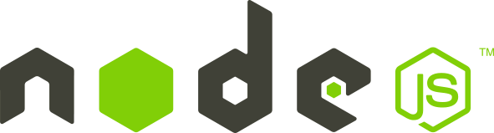
Install Node.js

Slide 3



Install a real command line
or
?
Good to go!
http://babun.github.io

Slide 4







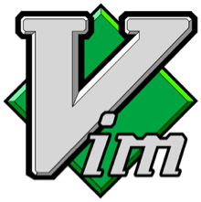



Install a real code editor (not Notepad)
Komodo IDE
TextMate
Sublime Text
Cloud9 IDE

Slide 5
Install Node.js & npm
https://nodejs.org/

Slide 6
Setup #4
Make it work!
Open your command line.
Type node and press enter. A new prompt should appear, indicating that you are in the Node.js console.
Type 1 + 2 and press enter. Node.js should give you the result.
(Type 0.1 + 0.2 if you want to see that your CPU can't count.)
$> node -v
4.3.1
$> node
> 1 + 2
3

Slide 7
Scaffolding with Yeoman

Slide 8


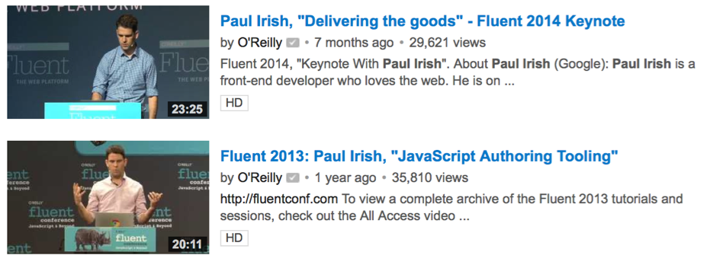
How do I bootstrap and structure my project?
Based on the specifications, we know that we will develop a REST API with Express, but we'll also use MongoDB and Mongoose, and probably other tools.
What should we do? Start from scratch or use some kind of skeleton? What are our options? What are the professional front-end developers doing?
https://www.youtube.com/watch?v=vDbbz-BdyYc

Slide 9
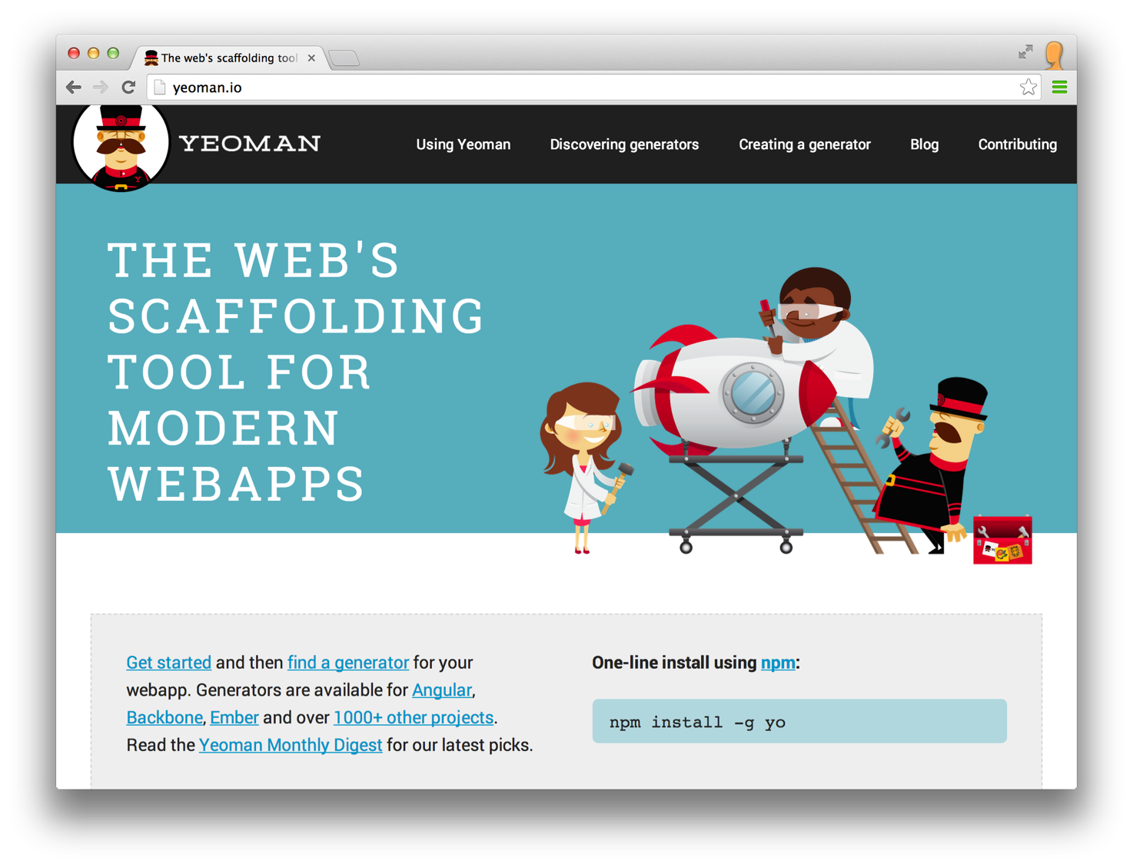
Meet Yeoman

Slide 10

What is Yeoman?
Yeoman is a combination of tools, which allows to you to setup a complete, automated, efficient and reliable development workflow.
Yo is a tool for generating project skeletons (scaffolding). You can create and share your skeletons. Yo generators are npm modules and you can find one for most popular web frameworks.
Bower is a tool for managing “web dependencies”. Not only javascript modules, but also CSS files, images, etc.
Grunt is a task runner. It is the tool that drives your automated process, by executing a series of tasks. There are lots of grunt plugins provided by the community for all aspects of your project.

Slide 11
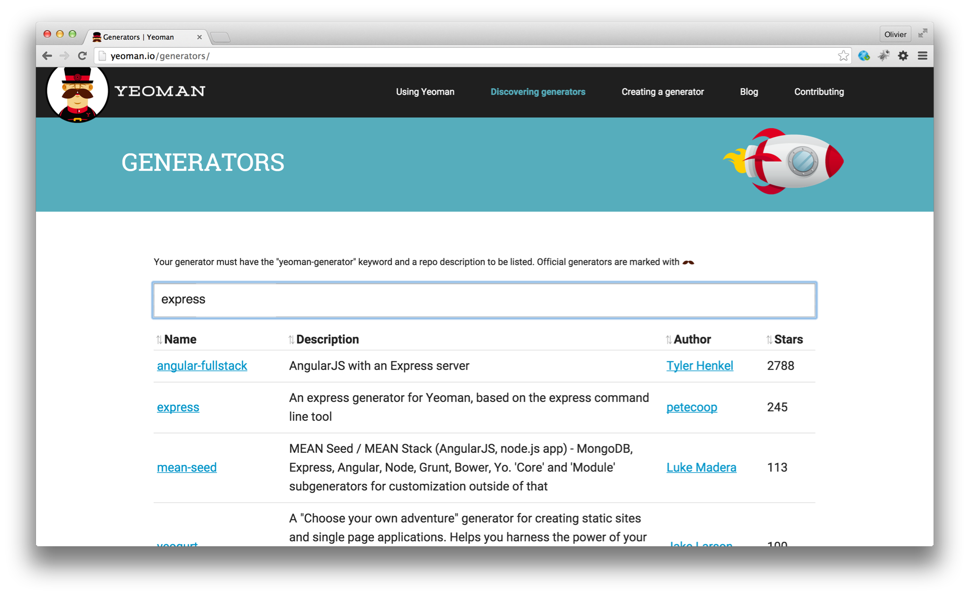
What is Yeoman?

Slide 12
Install Yeoman
http://yeoman.io/learning/
$> sudo npm install -g npm
$> sudo npm install -g bower grunt-cli yo

Slide 13
How do you pick a generator for your project?
You probably have an idea of the framework(s) you want to use on the server and or client side (express, angular, backbone, etc.). You will use this as a first filter.
Some of the generators are supported by the Yeoman Team. That is probably a good indication about the quality and support over time (evolution).
Developers who use generators can “star” those they like. Sorting by popularity is also an interesting indication. If the community is big, you can expect issues to be reported and fixed, to see new features, etc.
After you have identified promising candidates, you need to get a first impression. Generate and build a project with each candidate. Look at their Github repository. Do you like what you see? Do you like the documentation?
Often, you will need to choose between “lightweight” and very “rich” generators. Lightweight generators are easier to learn and give you more control (but more work). Rich generators do a lot of things out-of-the-box but can be intimidating at first (learning curve to understand the skeleton).

Slide 14
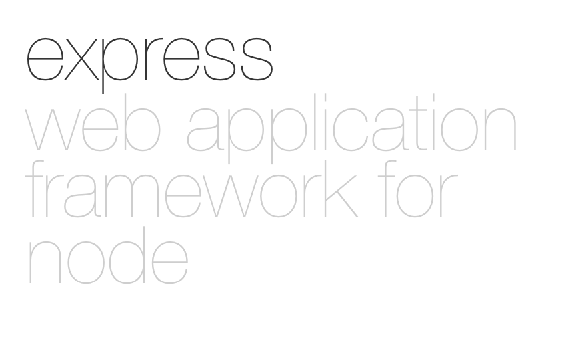
Express.js

Slide 15
Express.js: core functionality
Implementation of the Model View Controller (MVC) pattern
Routing
  Mapping between HTTP request attributes (URL, method, etc.) and controllers (handlers)
Middleware
  Interception and possibly transformation of HTTP requests and responses during their processing.
Template engines
  Rendering of views with pluggable template engines.

Slide 16
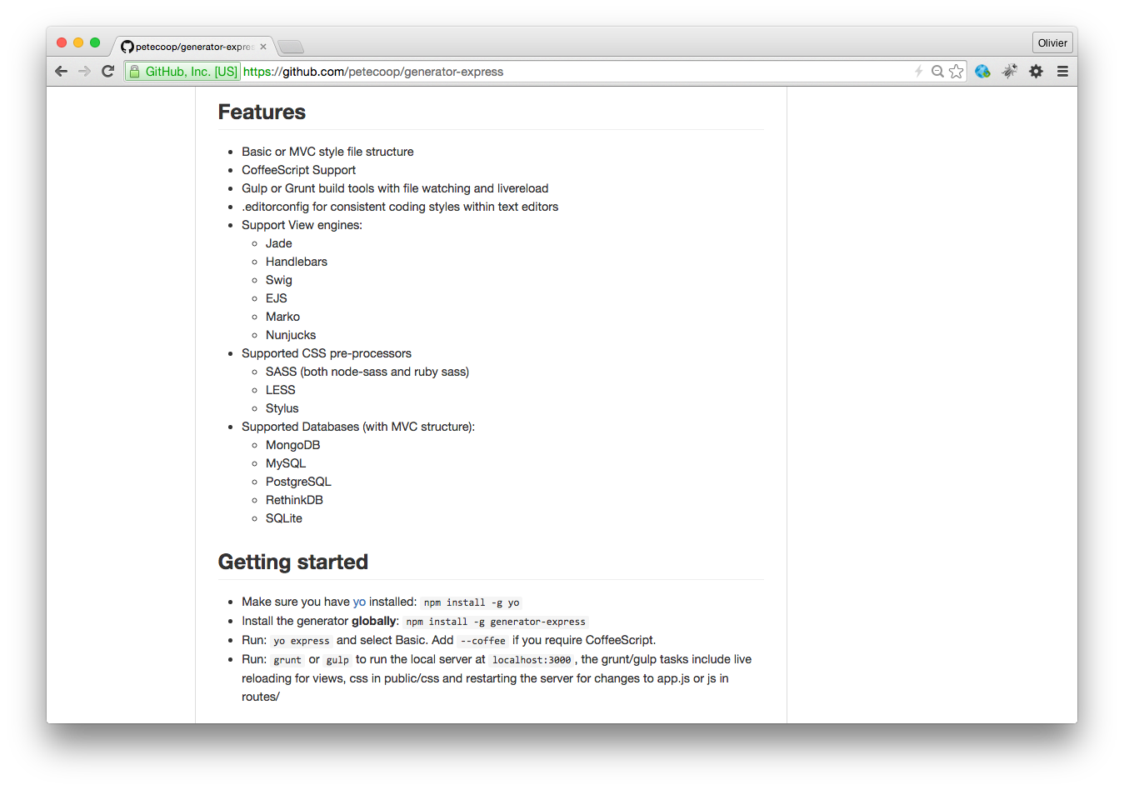
Meet the Yeoman express generator.

Slide 17
Why and when is this generator interesting?
It is more powerful than the standard generator provided by the Express.js framework.
It allows you to easily integrate persistence , with a choice of several relational (e.g. MySQL) and NoSQL (e.g. MongoDB) data stores. In that sense, it generates a full multi-tiered MVC application.
It comes with a Grunt file, which includes the live reload plugin.
The generated skeleton and Grunt file are rather lightweight and straightforward. It is fairly easy to get into the generated code and to add your application-specific code.

Slide 18
Install the Yeoman Express generator
$> npm install -g generator-express

Slide 19

$> cd /path/to/express/project
$> yo express
? Would you like to create a new directory for your project? No
? Select a version to install: MVC
? Select a view engine to use: Jade
? Select a css preprocessor to use (Sass Requires Ruby): Stylus
? Select a database to use: MongoDB
? Select a build tool to use: Grunt
create bower.json
create package.json
create .bowerrc
create .editorconfig
create .gitignore
create app.js
create app/controllers/home.js
create app/models/article.js
create config/config.js
create config/express.js
create app/views/error.jade
create app/views/index.jade
create app/views/layout.jade
create public/css/style.styl
create Gruntfile.js
I'm all done. Running npm install & bower install for you to install the required dependencies. If this fails, try running the command yourself.

Slide 20
Express uses a Model-View-Controller (MVC) structure

Slide 21
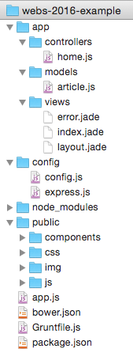
Express File Structure
controller (HTML view or API resource)
model (data access with Mongoose)
view (Jade templates compiled to HTML)
configuration
client-side assets (CSS, JS, images, etc)
entry point
bower package definition
tasks configuration
npm package definition

Slide 22
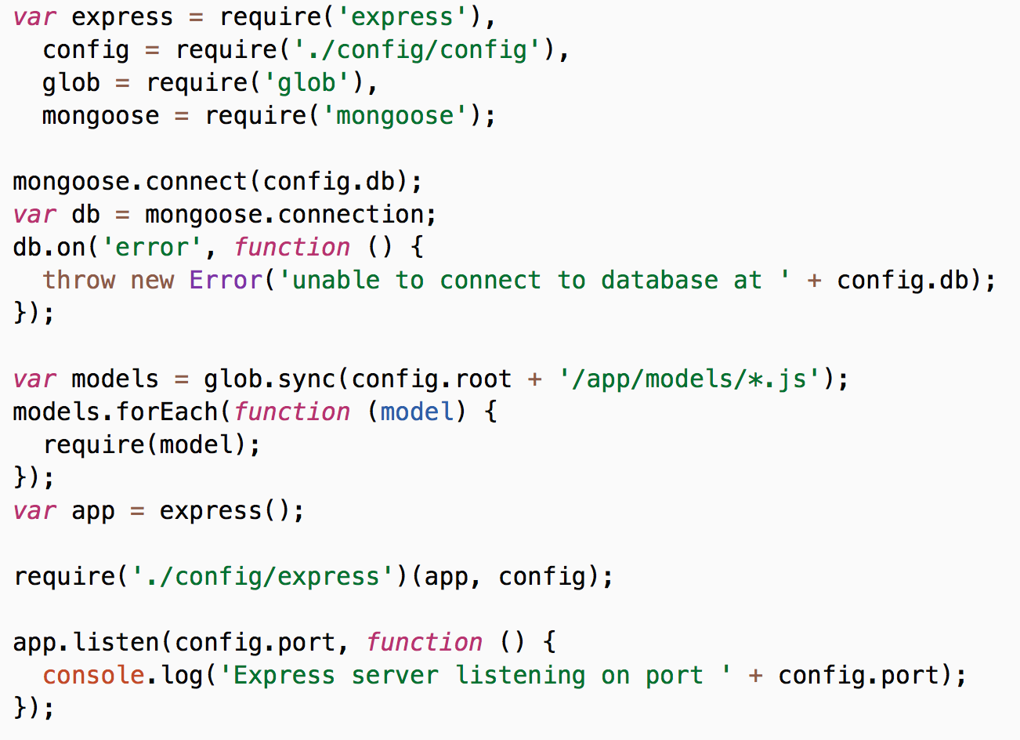
Express Entry Point: app.js
dependencies
npm packages
local modules
database connection
asynchronous callback on event
models
configuration
start the server
asynchronous callback function

Slide 23
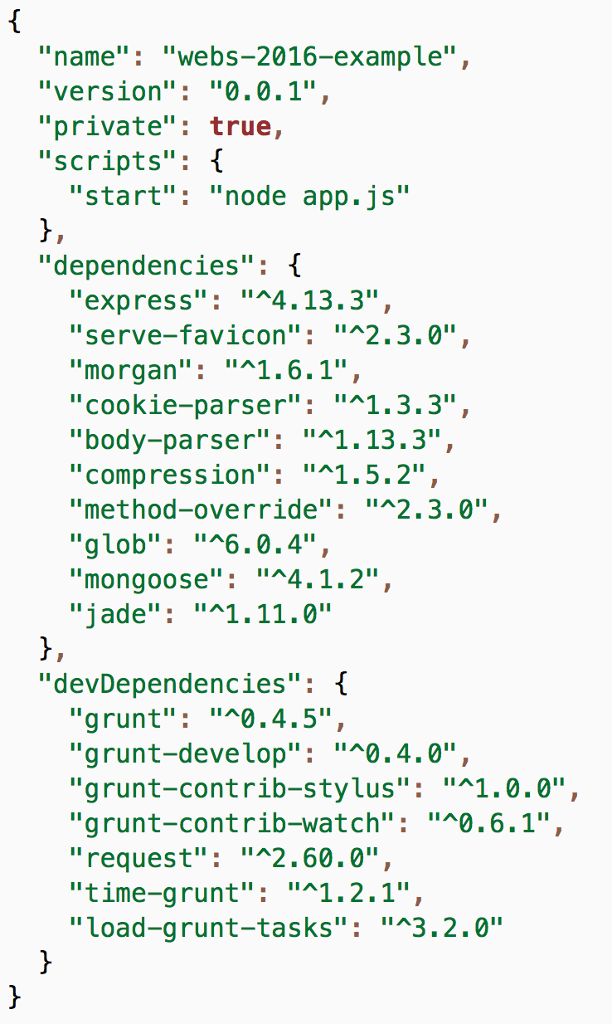
Your Express app's package.json:
how to start it
the express package
express middleware packages
other dependencies
development tools (not used in production)

Slide 24
Express.js Middleware

Slide 25
Express.js: middleware (filters)
Incoming HTTP requests can be processed by multiple components, organized in a pipeline
The components can inspect and even modify the incoming HTTP requests and HTTP responses (think about security, compression, etc.).
Express.js calls these components "middleware" functions
Middleware can be chained. They can intercept requests at different levels (all requests, requests under a certain path, requests handled by a specific router, etc.)
Built-in middleware components are available (in separate npm modules).
We will use the express.static middleware to serve static content (e.g. HTML)

Slide 26
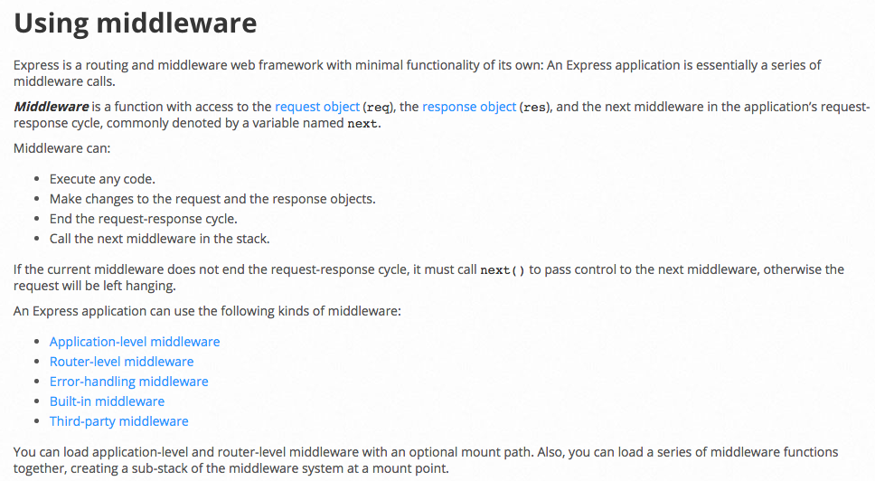
From the API reference

Slide 27
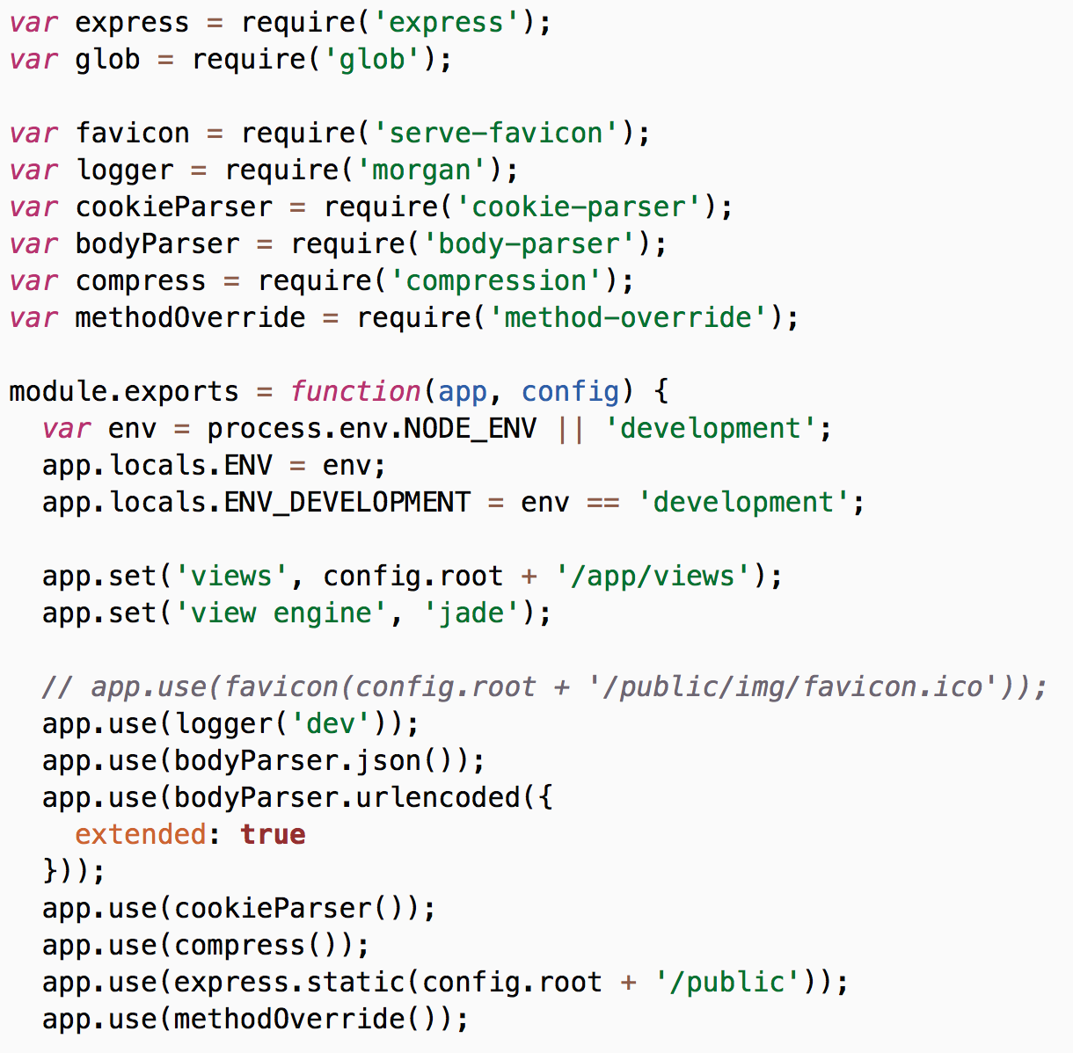
Express Configuration: config/config.js
third-party middleware packages
use the middleware one after the other; each can modify the request, send a response, or pass the request along to the next middleware
…

Slide 28
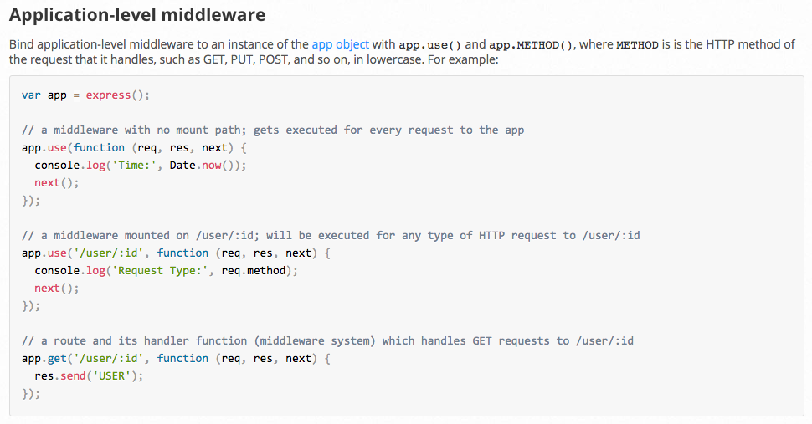
From the API reference

Slide 29
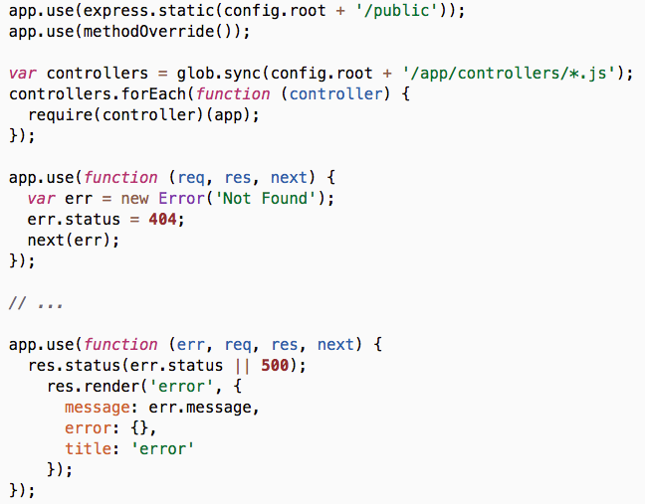
Adding your own middleware
…
middleware packages
controllers used as middleware
last middleware that will catch requests not already handled
error-handling middleware

Slide 30
Express.js Routing

Slide 31
Express.js: server-side routing
Routing consists in finding some piece of code (a function) to execute when an HTTP request has been issued.
We will see later (in a few weeks) that routing can happen on the client side. Today, we are looking at routing on the server side.
Routing is part of the typical Model-View-Controller (MVC) pattern implemented by web frameworks (not only in JavaScript, but also in other languages).
Routing consists in finding the right controller when a request comes in.
The controller will then get a model and delegate the rendering of a view to a template engine.

Slide 32
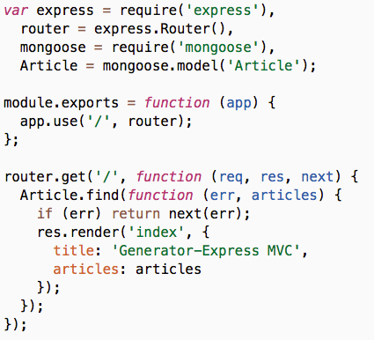
The home page
In app/controllers/home.js
Express Router
Add the router as middleware (filtered by path)
Define a route: GET /

Slide 33
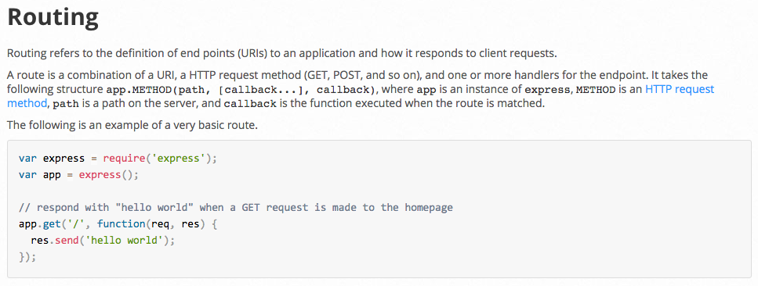
From the API reference
Route methods (GET, POST, PUT)
Route paths ('/', '/home', '/students')
Request and response objects

Slide 34
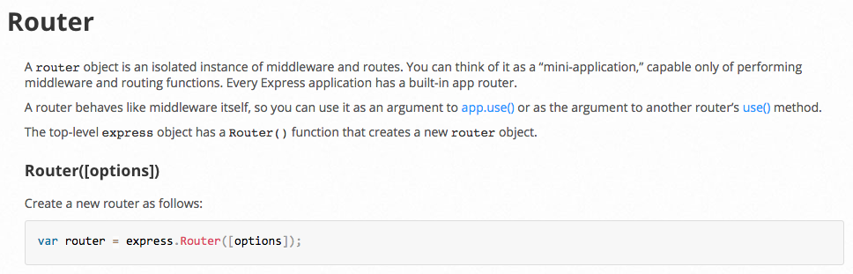
From the API reference
For large applications, it is better to split the controllers in multiple, isolated components. You should use multiple routers for that purpose.
express.Router() creates a new router. (no need for r = new Router())

Slide 35
Express.js resources
Documentation
http://expressjs.com/en/4x/api.html

Slide 36

MongoDB

Slide 37
NoSQL database

Slide 38
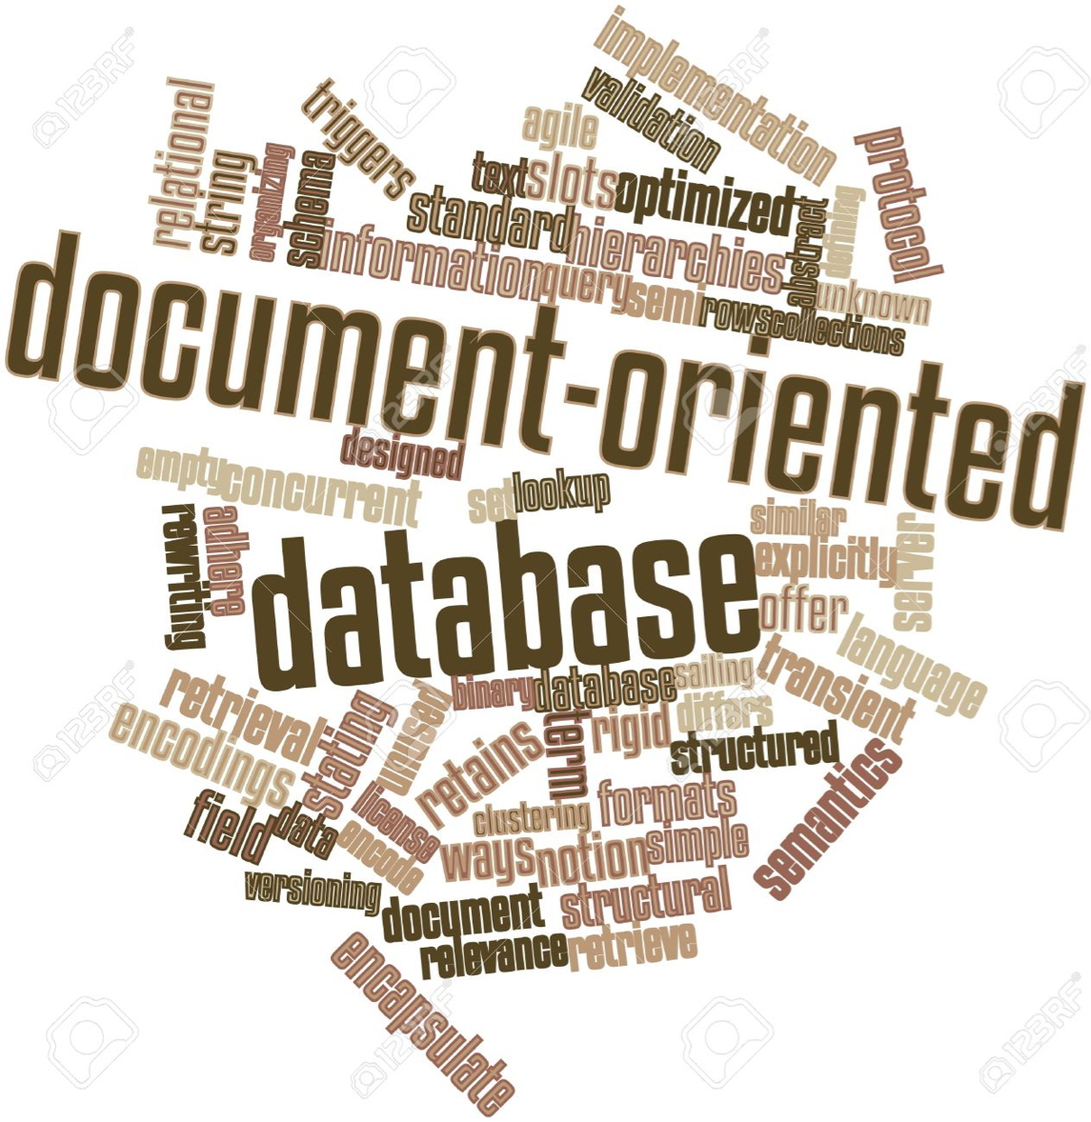

Slide 39
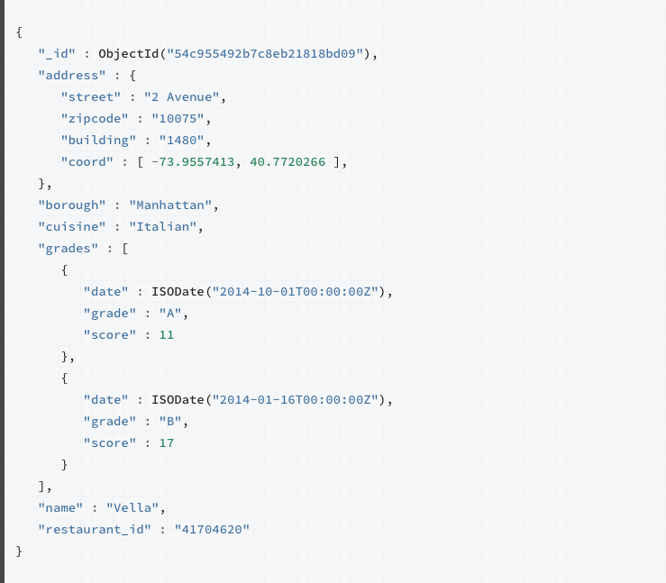
Store JSON-like documents

Slide 40
Schema-less collections
Collection (~ SQL table, but no schema)
things
{
"fruit": "orange",
"family": "Rutaceae"
"color": "#ff9900"
}
{
"name": "John Doe",
"age": 24
}
{
"drink": "Coffee",
"milk": false,
"sugar": "lots"
}
{
"fruit": "lemon",
"acidity": 15.6
}
Free-form documents (~ SQL table row)

Slide 41
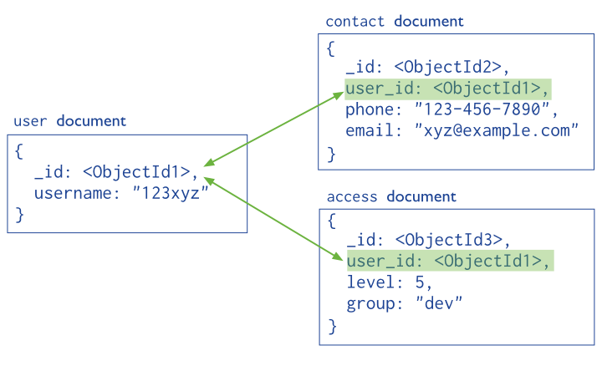
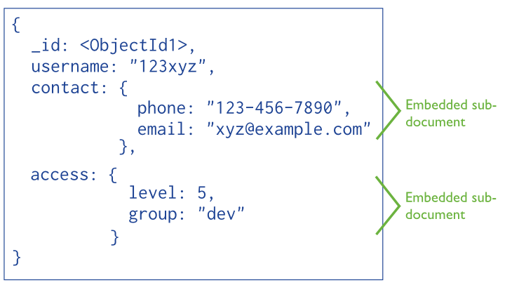
Data modeling
Creating a data model with MongoDB does not have to follow the rules that apply for relational databases. Often, they should not.
Consider theses questions: is this a composition relationship (containment)? Is this "aggregate" of documents often used at the same time (i.e. can we reduce chattiness)? Would embedding lead to "a lot" of data duplication?
Normalized data model
(references)
Embedded data model
(sub-documents)
https://docs.mongodb.org/manual/core/data-modeling-introduction/

Slide 42
Install & start MongoDB
https://www.mongodb.org
After downloading MongoDB, you must follow the installation procedure for your platform:
https://docs.mongodb.org/manual/installation/#tutorials

Slide 43
Test MongoDB on Linux/OS X
As long as you have set up your PATH correctly, you should be able to enter the MongoDB console from your command line, and insert and find some data:
$> mongo
MongoDB shell version: 3.2.3
connecting to: test
> db.things.insert({ "fruit": "apple" })
WriteResult({ "nInserted" : 1 })
> db.things.insert({ "name": "John Doe", "age": 24 })
WriteResult({ "nInserted" : 1 })
> db.things.find()
{ "_id" : ObjectId("56ca09b5d536b4526d219ba8"), "fruit" : "apple" }
{ "_id" : ObjectId("56ca095ed536b4526d219ba7"), "name" : "John Doe", "age" : 24 }

Slide 44
Test MongoDB on Windows
MongoDB looks for a /data/db directory by default. You can create it in Babun with the following command:
$> mkdir -p /c/data/db
To run the MongoDB server, run the following command in Babun (adapt the path if your MongoDB installation is elsewhere):
$> "/c/Program Files/MongoDB/Server/3.2/bin/mongod.exe"
2016-02-22T07:25:52.998+0100 I CONTROL [initandlisten] MongoDB starting : pid=203 port=27017 dbpath=/opt/local/var/db/mongodb 64-bit host=Phaeton.local
2016-02-22T07:25:52.999+0100 I CONTROL [initandlisten] db version v3.0.7
2016-02-22T07:25:52.999+0100 I CONTROL [initandlisten] git version: nogitversion
2016-02-22T07:25:52.999+0100 I CONTROL [initandlisten] build info: Darwin tenten-slave.macports.org 14.5.0 Darwin Kernel Version 14.5.0: Wed Jul 29 02:26:53 PDT 2015; root:xnu-2782.40.9~1/RELEASE_X86_64 x86_64 BOOST_LIB_VERSION=1_49
2016-02-22T07:25:52.999+0100 I CONTROL [initandlisten] allocator: system
2016-02-22T07:25:52.999+0100 I CONTROL [initandlisten] options: { storage: { dbPath: "/opt/local/var/db/mongodb" }, systemLog: { destination: "file", logAppend: true, path: "/opt/local/var/log/mongodb/mongodb.log" } }
2016-02-22T07:25:57.514+0100 I NETWORK [initandlisten] waiting for connections on port 27017
If you see Waiting for connections on port 27017, it means your MongoDB server is running. It will keep running until you hit Ctrl-C to stop it.

Slide 45
Test MongoDB on Windows
To run a MongoDB client, you must use the Windows command line and not Babun, as there are interaction bugs with Babun:
$> "C:\Program Files\MongoDB\Server\3.2\bin\mongo.exe"
MongoDB shell version: 3.2.3
connecting to: test
> db.things.insert({ "fruit": "apple" })
WriteResult({ "nInserted" : 1 })
> db.things.insert({ "name": "John Doe", "age": 24 })
WriteResult({ "nInserted" : 1 })
> db.things.find()
{ "_id" : ObjectId("56ca09b5d536b4526d219ba8"), "fruit" : "apple" }
{ "_id" : ObjectId("56ca095ed536b4526d219ba7"), "name" : "John Doe", "age" : 24 }

Slide 46
Getting started with MongoDB
We will learn more tomorrow.
This guide will instruct you on how to insert, find, update and remove documents:
https://docs.mongodb.org/getting-started/shell/

Slide 47
Running the Express application
With MongoDB running, you should be able to run the Express application. Open your command line, go to the directory where you used Yeoman to generate the Express app, and run npm start:
$> cd /path/to/express/project
$> npm start
> webs-2016-example@0.0.1 start /path/to/express/project
> node app.js
Express server listening on port 3000
Open http://localhost:3000 in your browser.

Slide 48

Mongoose

Slide 49
Mongoose: an ODM for MongoDB
“Mongoose provides a straight-forward, schema-based solution to modeling your application data and includes built-in type casting, validation, query building, business logic hooks and more, out of the box.”
Schema
“Everything in Mongoose starts with a Schema. Each schema maps to a MongoDB collection and defines the shape of the documents within that collection.”
Model
“Models are fancy constructors compiled from our Schema definitions.”
Document
“Mongoose documents represent a one-to-one mapping to documents as stored in MongoDB. Each document is an instance of its Model.”
http://mongoosejs.com/docs/guide.html

Slide 50
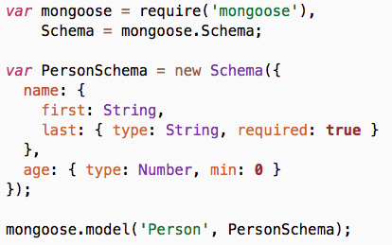
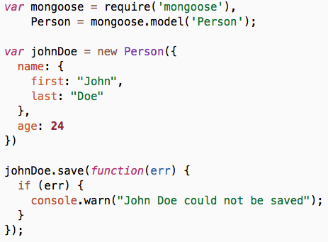
Mongoose example
Define a schema
Create a model to manage documents with that schema and store them in a MongoDB collection
Create a document with the model
Save it

Slide 51
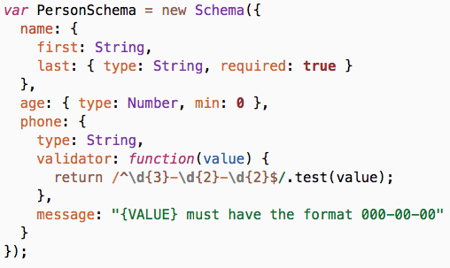
Mongoose validations
Mongoose has built-in validations, and you can also write your own
Ensure a property is present with required
Ensure a number is within bounds with min/max
Write your own validator function and custom error message
http://mongoosejs.com/docs/validation.html

Slide 52
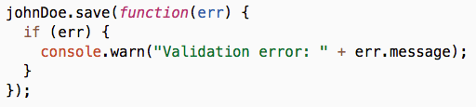
Mongoose validations
If your document is invalid, the callback function will be called with an error describing which validations have failed.
http://mongoosejs.com/docs/validation.html

Slide 53
Mongoose queries
you can chain conditions
Person
.find({ occupation: /host/ })
.where('name.last').equals('Ghost')
.where('age').gt(17).lt(66)
.where('likes').in(['vaporizing', 'talking'])
.limit(10)
.sort('-occupation')
.select('name occupation')
.exec(callback);
get at most 10 documents
retrieve only the fields you are interested in

Slide 54
Mongoose resources
Quick start guide
http://mongoosejs.com/docs/index.html
Queries
http://mongoosejs.com/docs/queries.html
Full documentation
http://mongoosejs.com/docs/guide.html

Slide 55
Grunt: The JavaScript Task Runner

Slide 56
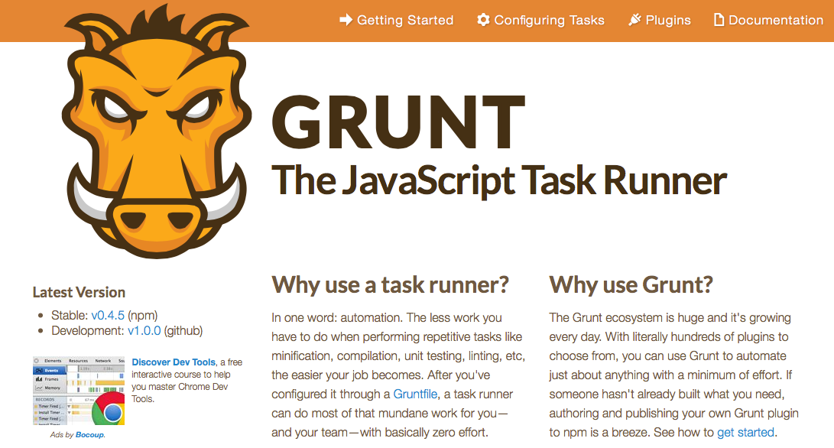
What is Grunt?

Slide 57

Grunt plugins
The Yeoman express generator has already integrated Grunt and included a few plugins for us.

Slide 58
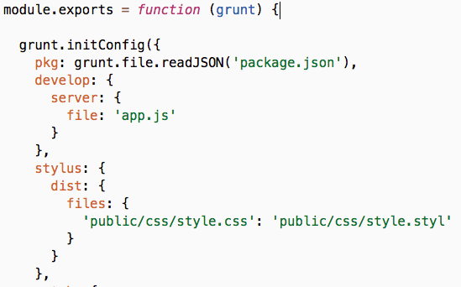
The Gruntfile
The Gruntfile is where Grunt plugins are configured.
The grunt-develop plugin runs our app and reloads it every time we make a change.
The grunt-contrib-stylus plugin compiles Stylus files to CSS.
And more…
…
You can run these plugins from the command line:
$> grunt develop
$> grunt stylus

Slide 59
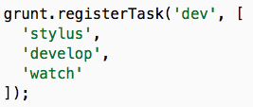
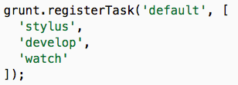
Composing tasks
You can run multiple plugins at once by registering a task.
$> grunt dev
The default task is the task that is invoked if you simply run grunt without an argument.
$> grunt

Slide 60
Let's make a REST API

Slide 61


Testing tools
Google Chrome
Postman

Slide 62
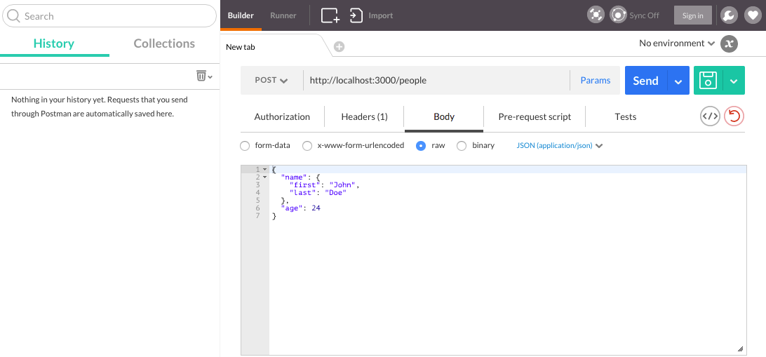
Postman
URL
HTTP headers
Request body

Slide 63
Universal interface
CRUD
Create
Read
Update
Delete

Slide 64
CREATE RUD
Request
Response
POST /people HTTP/1.1
Content-type: application/json
{
"name": {
"first": "John",
"last": "Doe"
},
"age": 24
}
HTTP/1.1 201 Created
Content-type: application/json
{
"_id": "3orv8nrg",
"name": {
"first": "John",
"last": "Doe"
},
"age": 24
}
The POST method is used to request that the origin server accept the entity enclosed in the request as a new subordinate of the resource identified by the Request URI.
HTTP 201 Created: The request has been fulfilled and resulted in a new resource being created.

Slide 65
C READ U D
Request
Response
GET /people HTTP/1.1
HTTP/1.1 200 OK
Content-type: application/json
[
{ "_id": "3orv8nrg", … },
{ "_id": "a08un2fj", … }
]
The GET method means retrieve whatever information (in the form of an entity) is identified by the Request URI.
HTTP 200 OK: Standard response for successful HTTP requests. In a GET request, the response will contain an entity corresponding to the requested resource.

Slide 66
C READ U D
Request
Response
GET /people/3orv8nrg HTTP/1.1
HTTP/1.1 200 OK
Content-type: application/json
{
"_id": "3orv8nrg",
"name": {
"first": "John",
"last": "Doe"
},
"age": 24
}

Slide 67
CR UPDATE D
Request
Response
PUT /people/3orv8nrg HTTP/1.1
Content-type: application/json
{
"name": {
"first": "John",
"last": "Smith"
},
"age": 34
}
HTTP/1.1 200 OK
Content-type: application/json
{
"_id": "3orv8nrg",
"name": {
"first": "John",
"last": "Smith"
},
"age": 34
}
The PUT method requests that the enclosed entity be stored under the supplied Request URI. If the Request URI refers to an already existing resource, the enclosed entity SHOULD be considered as a modified version of the one residing on the origin server.
HTTP 200 OK: In a PUT request, the response will contain an entity describing or containing the result of the action.

Slide 68
CRU DELETE
Request
Response
DELETE /people/3orv8nrg HTTP/1.1
HTTP/1.1 204 No Content
Content-type: application/json
The DELETE method requests that the origin server delete the resource identified by the Request URI.
HTTP 204 No Content: The server successfully processed the request, but is not returning any content.

Slide 69
HTTP resources
HTTP request methods
HTTP status codes

Slide 71

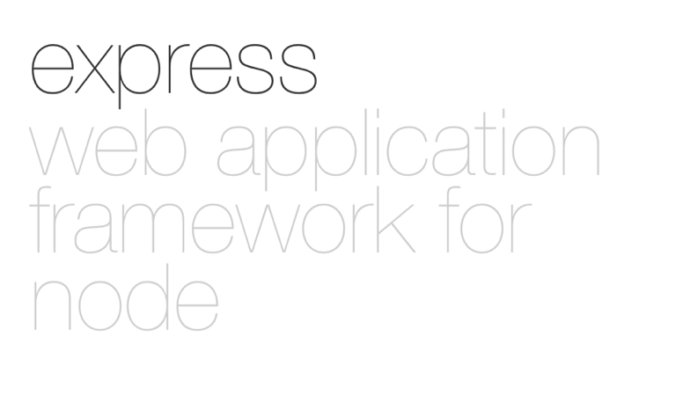

Technologies
Postman

